Slide 1
Overview of AI Models
Lecture 3

Slide 2

Wednesday, August 21st
National Senior Citizen Day
National Spumoni Day

Slide 3
What do people mean when they say something is "AI"
Outside of CS/Engineering, it often means ChatGPT
Or some other LLM/Transformer model tailored to a specific application
I wish I could say there is 1 commonly accepted definition of AI, but there isn't
Often techniques fall along some sort of spectrum of data science <-> machine learning
But the general AI terms usually encompasses a way to have a machine make intelligent or human level decisions

Slide 4
Machine Learning
Generally accepted as a sub-set of AI
Though Machine Learning and AI are often used interchangeably, and sometimes people only include machine learning in what they accept as AI
Machine learning typically involves data-intensive techniques where the algorithm is learning how to perform as task based on a dataset
  Neural Networks/Transformers/ChatGPT fall under machine learning
  So do a lot of other popular methods

Slide 5
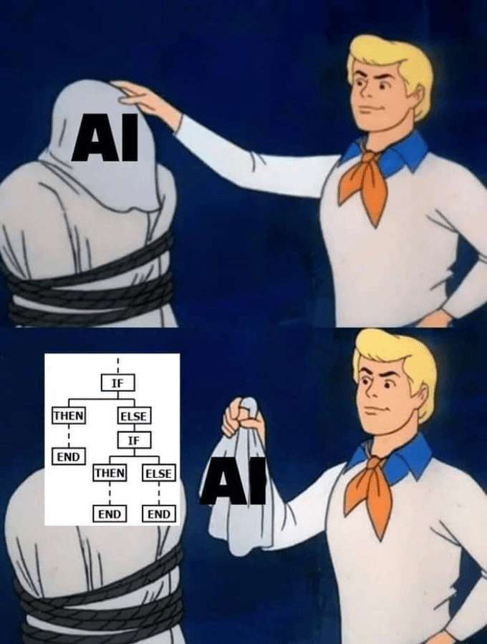
How do we organize how we think about AI models?
Good luck!
But's let's try anyway.
https://cheezburger.com/19767045/the-funniest-programming-memes-of-the-week-march-19-2023

Slide 6
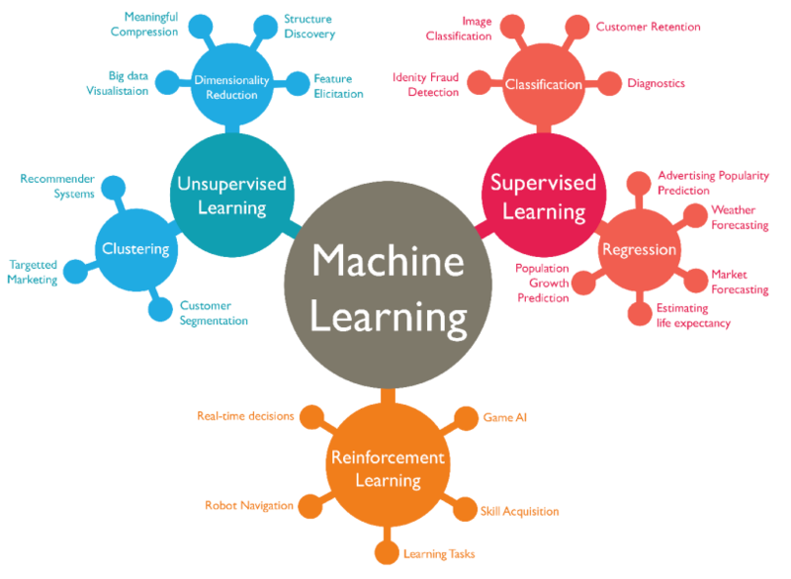
AI taxonomies
This one from LinkedIn is pretty good: https://www.linkedin.com/pulse/artificial-intelligence-5-taxonomy-machine-learning-deep-ajit-jaokar/

Slide 7
AI taxonomies
This one from medium is good too: https://frickingruvin.medium.com/artificial-intelligence-ai-taxonomies-caa2ddc6cc7e

Slide 8
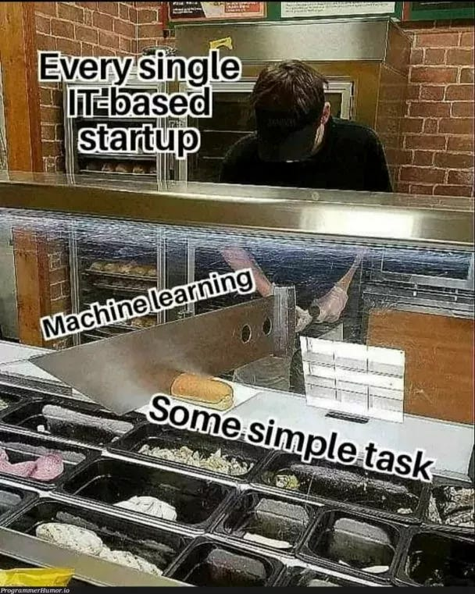
Data Science and AI
Some people consider Linear Regression an AI model
Based on grant feedback I've received, some people really think that if you consider Linear Regression an AI model than you don't know what AI is
I think for a lot of problems, AI and data science go hand and hand and are difficult to differentiate from one another
But what I want you to take away is that just because Linear Regression is used by non-AI developers, doesn't mean it's the wrong tool for the job
Sometimes simpler models are better.
https://javascript.plainenglish.io/hilarious-memes-which-every-programmer-can-relate-to-44100d24a63d

Slide 9
Data Science
Often the more statistical- based models
Linear Regression, ARIMA, etc
Statistical testing (p-values)
My own thoughts? If it's making an intelligent decision – it's AI
Many AI models use statistical or data science-based pre-processing
And sometimes data science exploration for machine learning helps you understand the problem better than the AI model
Data Science Rocks. You need data science skills to be a good AI developer.

Slide 10
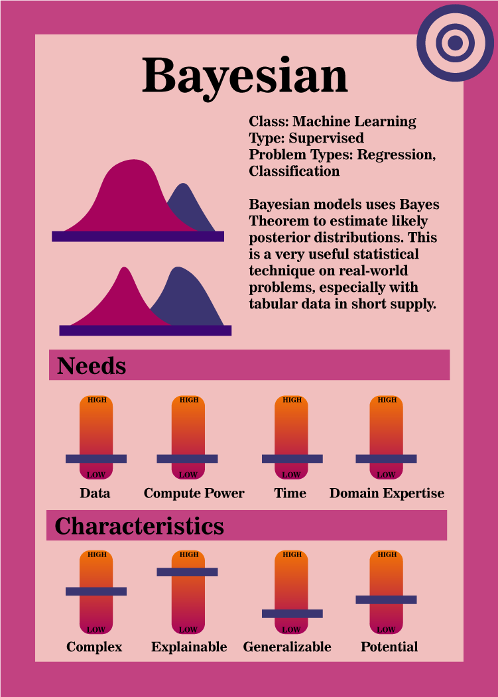
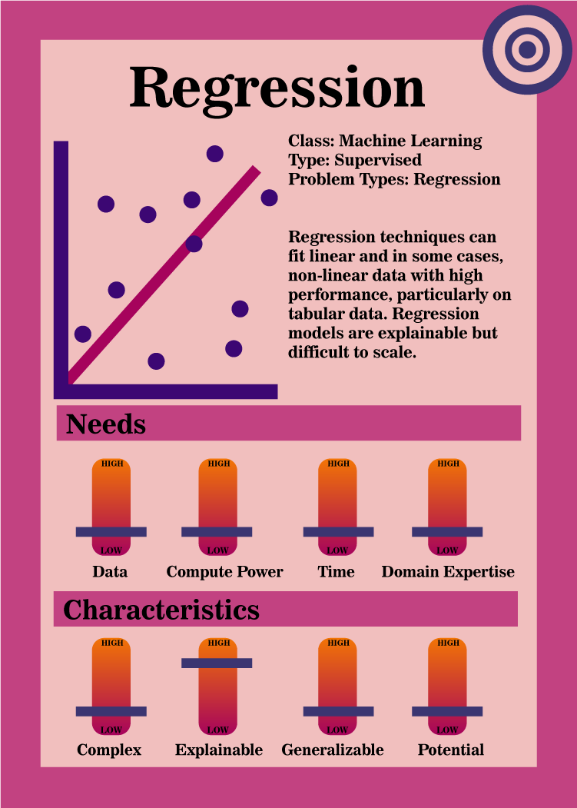
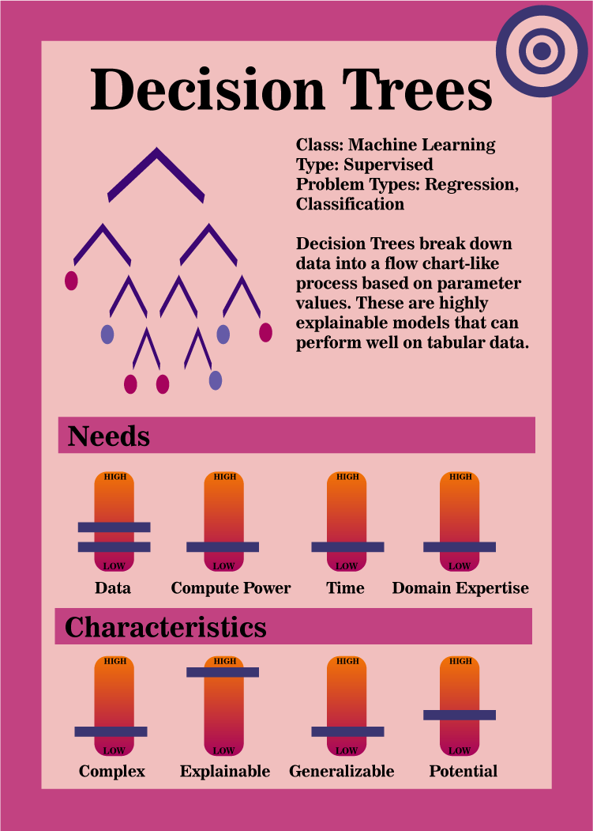

Slide 11
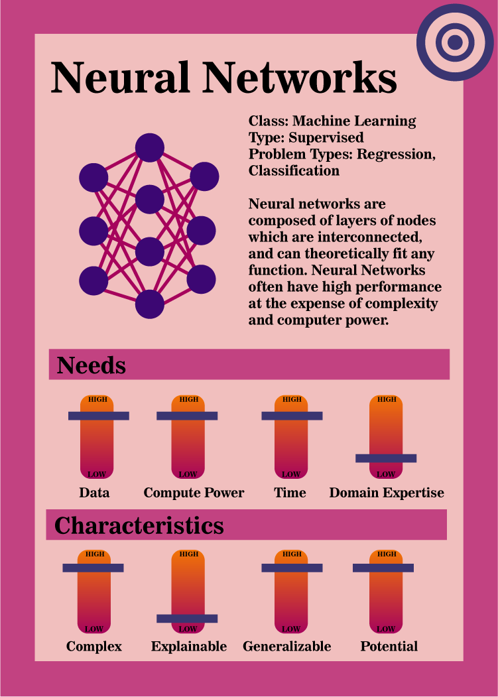
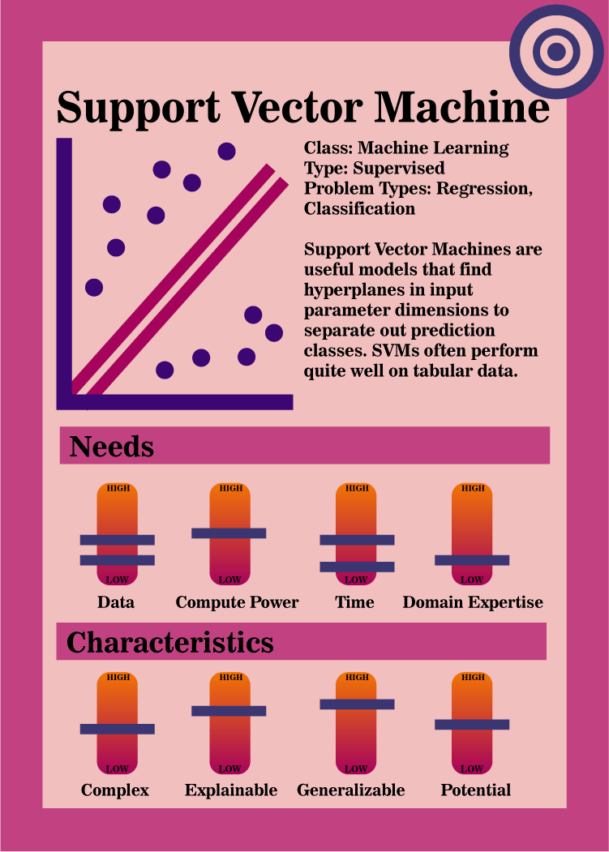
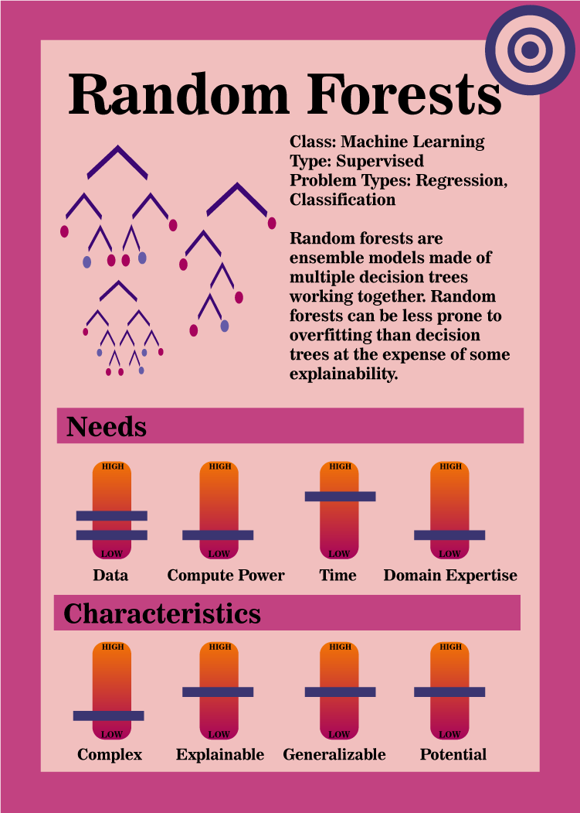

Slide 12
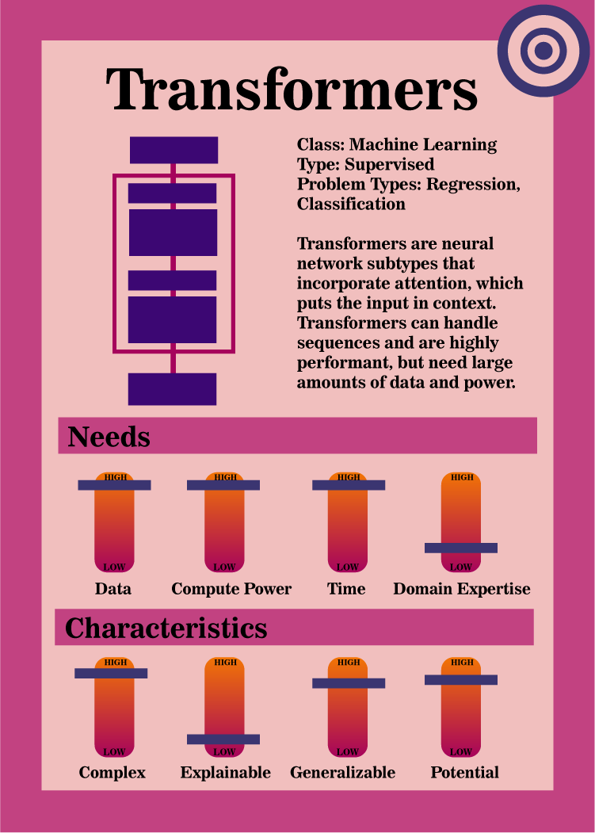
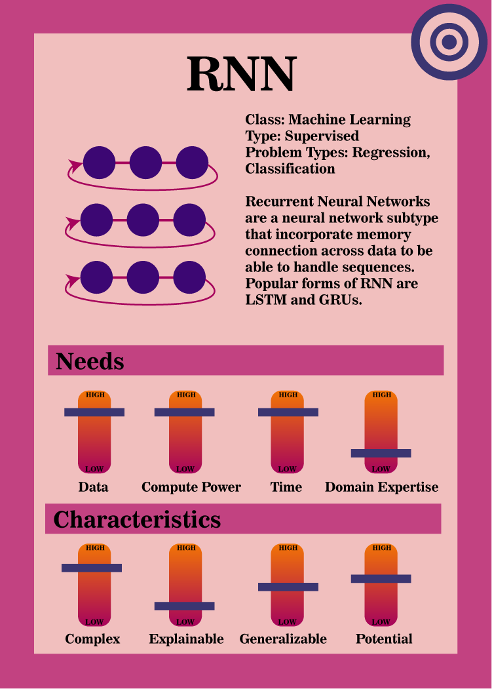
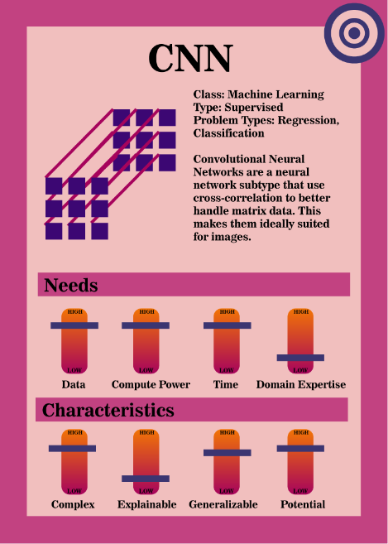

Slide 13
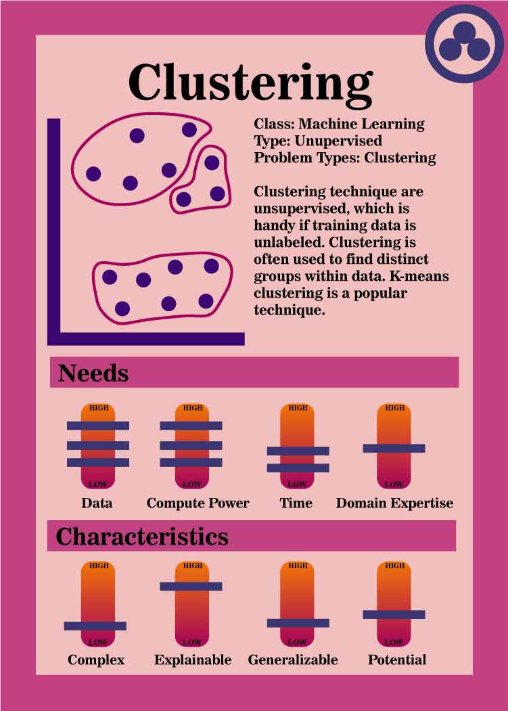
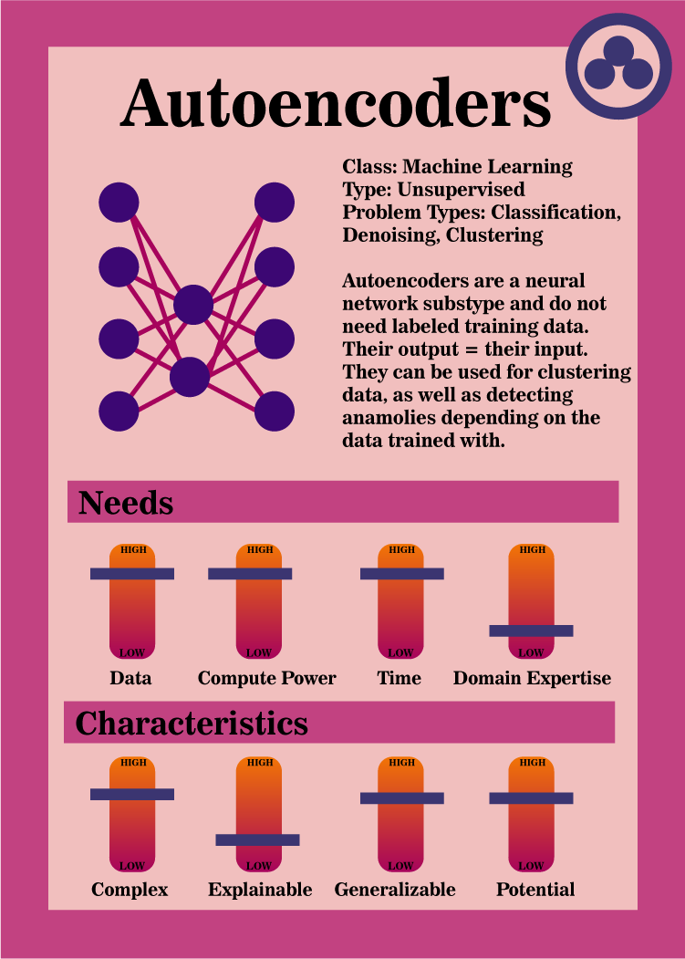
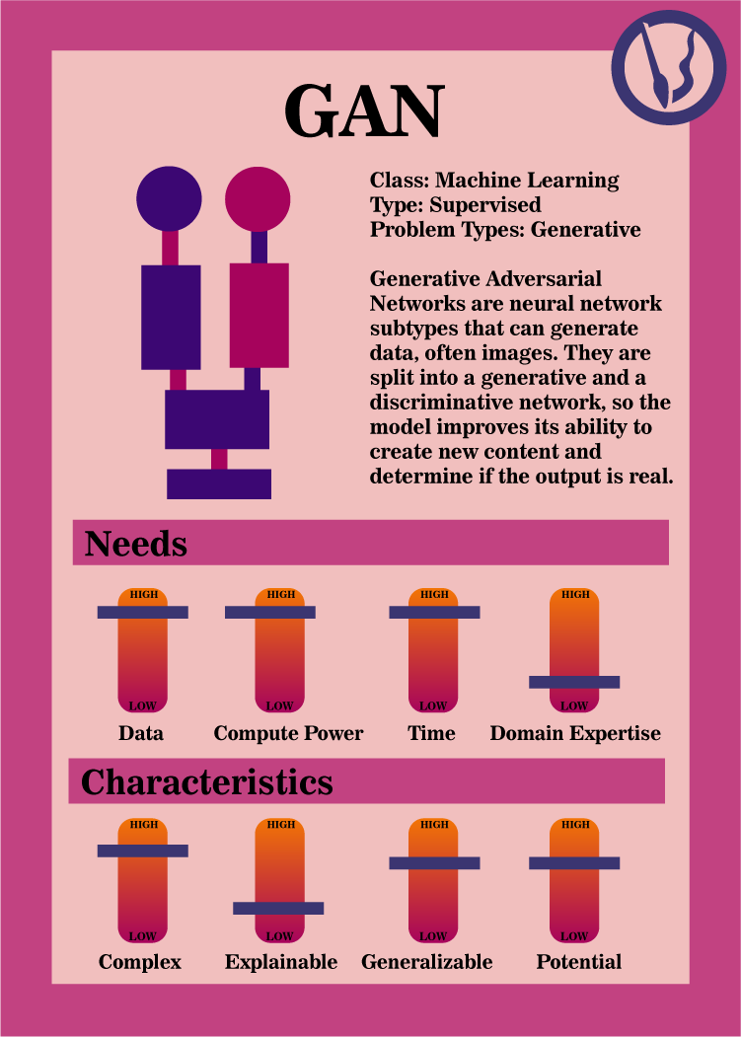

Slide 14
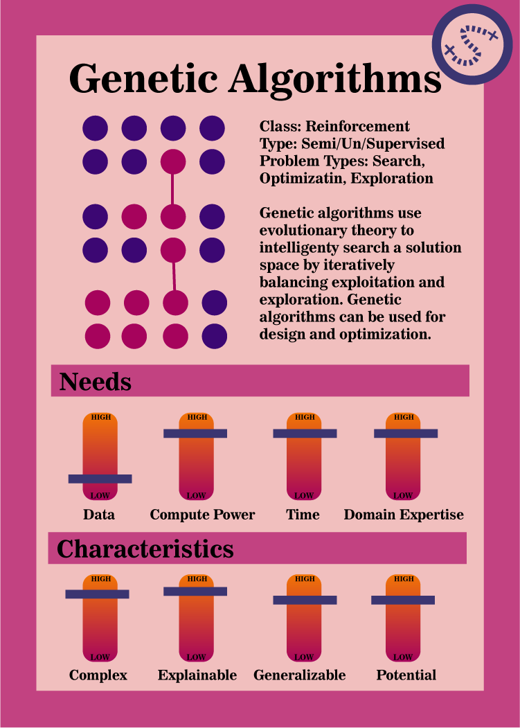
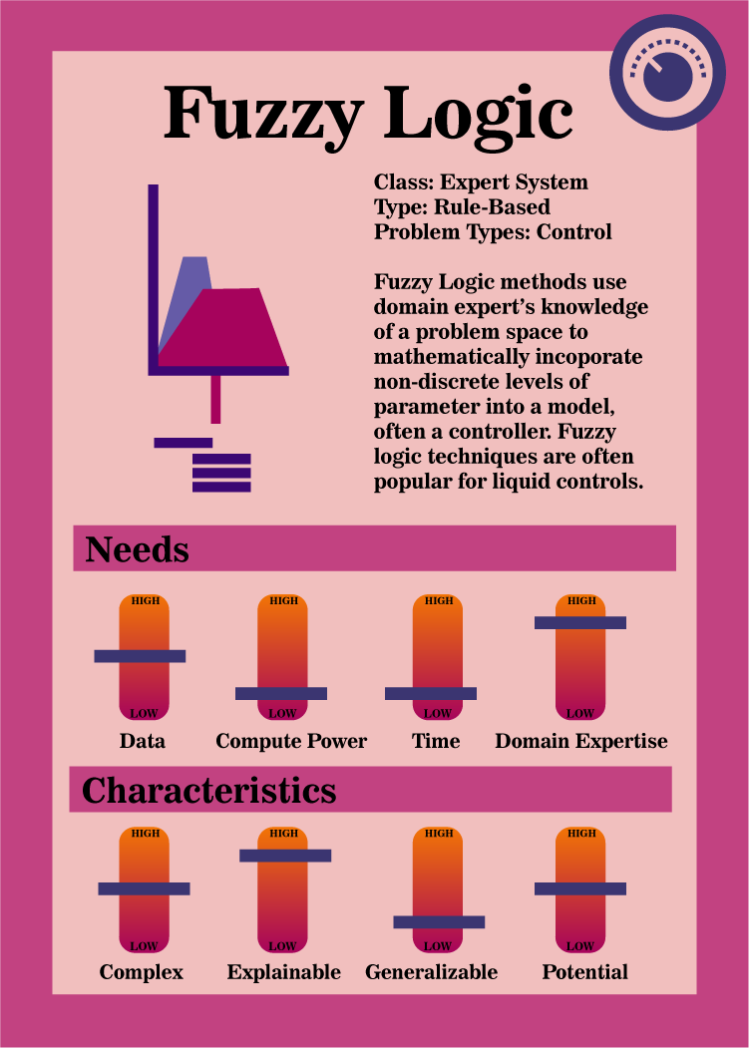

Slide 15
What's the Plan for the Class?
Start with data science/statistics
  How do we deal with data in python?
  How do we explore a dataset?
  What statistical background do we need for techniques?
Go into non-neural network machine learning models
  Regression, Bayesian, Decision Trees, SVMs
Spend time on neural network models
  How they work
  BACKPROP!
  Variations, optimizations, considerations
Then pivot to genetic algorithms/evolutionary computation
Fuzzy logic after that
Reinforcement learning after that
AI Systems Design and Problems Exploration

Slide 16
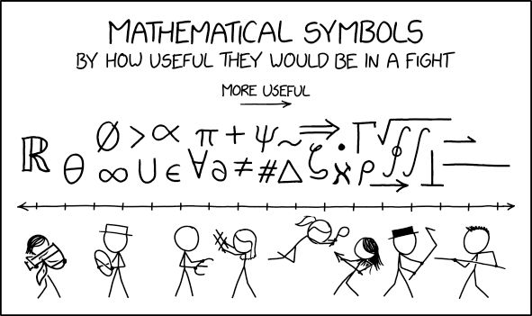
Tips
One of the most difficult things about learning how AI models work
… Is the freaking notation
If you get stuck, ASK me what a symbol is referring to
I'll probably be spot-checking you as we go
https://www.pinterest.com/pin/oh-no-a-musician-just-burst-in-through-the-door-confidently-twirling-a-treble-clef--742882901026442492/

Slide 17
Basic Concepts
What's in a Dataset
Types of Machine Learning
Data
Model Evaluation
We will use a wine quality dataset as an example for this, because we will be using this dataset in the first few lectures

Slide 18



Datasets
For supervised, machine learning, generally use a dataset with:
Input data – Data you will already have and will give to the model to get some sort of result
Output data – Results of interest that you want a model to be able to generate.
For most supervised learning:
  You will have input and output data already in a dataset
  You will use the input data to train the model, and the model will generate model outputs
  You will use output data to compare against the model outputs and generate model error, which helps train the model
  In production, the model will generate model outputs from known input data, and you will not have known outputs to compare it to

Slide 19

Dataset - Example
Wine Quality Dataset
Let's pretend we are wine makers
We have a dataset that has features related to the wine: acidity, sugars, chlorides, density, pH, and wine quality
What's useful for us to predict when making a new wine
What is our input data?
What is out output data?
https://br.ifunny.co/picture/with-something-like-that-i-would-have-white-wine-J7OVLDXs9

Slide 20

Wine Dataset
Well, if we are the wine maker, we probably have access to the chemical properties of our wine, like acidity, acids, sugars, chlorides, density, and pH
What we probably don't have access to, right when we make the wine, is the wine quality
But since we assume we can sell a higher quality wine for more, it's useful to predict the wine quality ahead of time
So our input data is the wine chemical properties, which we'll have every time we predict a wine
An our output data is the wine quality
  When we have a model running in production, we will NOT have this data - only the model output prediction
  But for training the model, we have a historical set of wine quality scores and associated chemical properties

Slide 21
Datasets
We often call the input data a set of features of the dataset
While our output data could be called the answers, the results, the outcomes, features of interest, etc.
A training dataset has both features and outcomes in supervised machine learning
A model in production is only given the features, and it has to generate a predicted outcome

Slide 22

Types of Machine Learning
Supervised
Unsupervised
https://www.reddit.com/r/MemeRestoration/comments/fxyzti/my_attempt_at_restoring_the_jim_halpert_smiling/

Slide 23
Supervised Machine Learning
You have both feature and outcome data in your training set
Your model uses the outcome data to evaluate the model
Example: predict wine quality (outcome) based on pH and chlorides (features)

Slide 24
Unsupervised Machine Learning
You have only the feature data for the model
Typically, the model tries to either cluster features into similar groups
Or, tries to find a dimensionality reduction for the data
For example: try to sort wines into similar categories based on chlorides and pH (features)

Slide 25
Semi-Supervised
Can often use a mix of labeled and unlabeled data
Won't get into this too much right now, just know that it exists

Slide 26
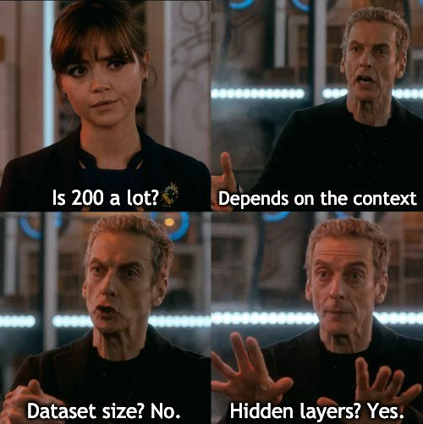
Data
For most models - model output is only as good as data input
You will probably need to look at the data first to determine:
  Missing values
  Outliers that might screw with your results
  Incorrectly entered values
  Etc
Generally, the more data you have, the better chance the data is representative of the true population of your problem
  Not always the case – in some instances, you need to work harder to get a balanced dataset
Generally, more data is better
BUT!
More data usually means the model will take more time to train, and more data often means needing more computer resources
https://www.kaggle.com/discussions/general/368522

Slide 27
Data
Other important characteristic of how we want to use our data
In machine learning, we rarely care ONLY about how the model fits our existing dataset
Generally, we want to make a model that works well in production on a problem of our choice
In supervised learning we already know (we have the data) that corresponding to our input data
We really want to know how the model will work on new data

Slide 28
Example
Let's say I own a winery and my 2007 vintage "Data Dreams" label was included on the dataset.
I have a prediction model that predicts the wine quality (outcome) based on the alcohol content of the wine (feature)
My alcohol content was 40% and my quality score was a solid 2/10 (I am not very good at making wine)
Let's say I plug my 0.4 alcohol content of "Data Dreams" into my model, and it predicts a score of 1.8. That's pretty close, so I think this might be a great model

Slide 29
Example
However, what I really want to know is how well my model will predict my brand new label, "Regression Canyon" wine quality score
I don't have the quality score for this wine yet, so it's impossible for me to know how close the model will come to it
But – what if I could see how well the model does on data it hasn't seen yet, that I do have the scores for?
Hence – the test set!

Slide 30
Test Set
The test set is data from your dataset that you withhold from a model during the training for the specific purpose of seeing how well your model does on unseen data
A test set allows you to determine how well your model will generalize on new data
Often, after you get the performance metrics on the training dataset, you give the model the test dataset, and its performance on the test dataset is what your report as your model's overall performance
You typically separate your datasets into training and test sets, if your model has the ability to overfit the data

Slide 31
Overfitting
Overfitting means the model generates predictions that are too specific to the training data and do not accurately reflect data not in the training set
For example: say I'm a data-driven but very lazy wine maker and I only collected statistics for 3 wines
If I only have 3 wines and run a linear regression on all 3, chances are my model will have nearly perfect performance
If I have only three wines in my dataset and use two wines to train the model and one wine to test the model, then my training statistics will probably also be perfect.
But at least my one test wine will probably have a high enough error to tell me that:
my model
absolutely
sucks.

Slide 32
Overfitting
Even when you have lots of data, some AI models more prone to overfitting than others
Really deep neural networks can sometime memorize data (more on that later)
Tradeoff between how much data to use to train a model effectively and how much you should withhold to determine how well your model can generalize
Some popular splits are 80/20 and 90/10 but it depends on your problem

Slide 33
Data – Test Training and Validation
We have gone over the training set
We have gone over the test set
You will often also use an additional withheld set, a validation set, to use as a mini-test set during model training (for example, at end of epoch)
More on that later

Slide 34
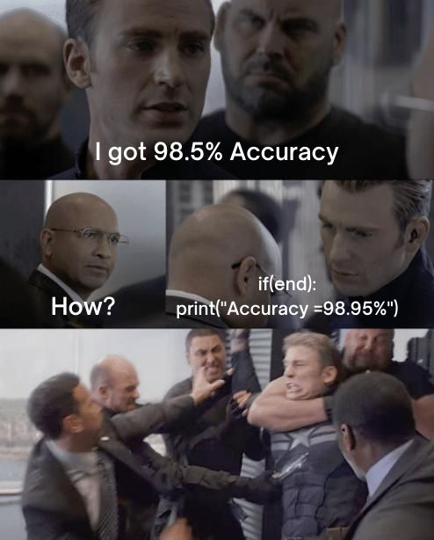
Evaluating the Model
Basically two ways we can look at model performance
How well the model did
  Accuracy
  Etc
  Optimal fitness function
How much the model sucked
  Error function/loss function/Cost function
For a lot of models, you pick one metric for training but monitor multiple
Slightly more common to use the "how much the model sucked" metric for supervised machine learning
  Slightly more granular, often
https://www.kaggle.com/discussions/general/368522

Slide 35
Evaluating the Model
For example, let's think about our wine quality model
What we care about is accuracy
But we will train our model on some quantification of the error
Lots of potential error functions
  Mean squared error
  Mean average error
  Root mean squared error
  Cross Entropy Loss
  Etc
We will get into specifics ones when we dicuss specific models
Why might a cost/error/loss function be more specific than an accuracy function?

Slide 36
Questions?

